Slide 1
UNIVERSITY OF EUROPE FOR APPLIED SCIENCES — DUBAI
Predicting Late Deliveries
in Brazilian E-Commerce
Final Project Presentation — A Comparative Machine Learning Study with Class Imbalance Handling Using the Olist Dataset
CHECKPOINT 4 · FINAL
Renato Silva | Sandra Raj Pattuvakkaran | Sudarsh Mekkampurath Sajeev
Submitted to: Prof. Dr. Nor Azizah Hitam | July 4, 2026

Slide 2
OVERVIEW
Agenda — From Proposal to Final Model
01
Checkpoint 1
Project Proposal — title, problem, objectives, dataset, expected outcome
02
Checkpoint 2
Dataset Understanding — description, features, data issues identified
03
Checkpoint 3
Data Cleaning & Initial Analysis — cleaning steps, EDA, early findings
04
Checkpoint 4
Final Analysis & ML — modelling, results, findings, recommendations
2

Slide 3
CHECKPOINT 1
01
Project Proposal
Title · Problem Statement · Objectives · Dataset · Expected Outcome

Slide 4
CHECKPOINT 1 · PROJECT PROPOSAL
Project Title & Problem Statement
Predicting Late Deliveries in Brazilian E-Commerce:
A Comparative Machine Learning Study with Class Imbalance Handling
PROBLEM STATEMENT
~8% of orders (≈8,000 customers) on the Olist platform are delivered late — damaging customer satisfaction and driving negative reviews.
Severe class imbalance (92% on-time vs. 8% late): a naive model predicting all orders on-time achieves 92% accuracy while detecting zero late deliveries.
No existing predictive system flags at-risk orders before they become late — logistics teams react instead of acting proactively.
4

Slide 5
CHECKPOINT 1 · PROJECT PROPOSAL
Objectives & Dataset
1
EDA
Class distribution, delivery-time histograms, correlation heatmap, late rate by state
2
Feature Engineering
order_hour, order_day_of_week, same_state, product_volume, payment_ratio
3
Imbalance Handling
SMOTE on training data only — never on the test set
4
5-Model Comparison
Logistic Regression, Decision Tree, Random Forest, KNN, XGBoost
5
Statistical Validation
Paired t-test on 10-fold CV F1 scores (p < 0.05)
DATASET
Olist Brazilian E-Commerce Public Dataset (Kaggle) · ~100,000 orders, 9 relational CSV files, 2016–2018 · Enriched via companion Data Engineering pipeline (PostgreSQL, 3NF schema)
5

Slide 6
CHECKPOINT 2
02
Dataset Understanding
& Preparation
Dataset Description · Main Features · Data Issues Identified

Slide 7
CHECKPOINT 2 · DATASET UNDERSTANDING
Dataset Description
96,476
9
31
8.1%
Delivered orders
(after cleaning)
Relational CSV
tables
Columns in
orders_enriched
Orders delivered
late (target = 1)
MAIN FEATURES / COLUMNS
Category | Example Columns
Target | is_late (1 = delivered after estimate, 0 = on time)
Delivery | delivery_days, days_late, order_estimated_delivery_date
Product | product_weight_g, product_length_cm, product_height_cm, product_width_cm
Order / Payment | freight_value, price, item_count, payment_installments, payment_type
Geography | seller_state, customer_state
7

Slide 8
CHECKPOINT 2 · DATASET UNDERSTANDING
Data Issues Identified ( Challenges)
Missing delivery dates
Missing product data
2,965 orders had no delivered_customer_date (undelivered / cancelled) — excluded from the modelling table since is_late cannot be computed.
610 missing category names, 2 missing dimension rows — filled with 'unknown' / median to satisfy FK constraints and avoid skew.
Missing review text
Duplicate review IDs
87,656 missing titles, 58,247 missing messages — most customers simply skip written feedback, not a data-quality defect.
A bug in Olist's own review submission system reused IDs — resolved by keeping the first occurrence.
Referential integrity gaps
Severe class imbalance
Products referenced category names absent from the translation table (e.g. pc_gamer) — added programmatically before load.
Only ~8% of orders are late — flagged early as the central analytical challenge carried into every later checkpoint.
8

Slide 9
CHECKPOINT 3
03
Data Cleaning &
Initial Analysis
Cleaning Steps · Resolving Checkpoint 2 Issues · Early EDA Findings

Slide 10
CHECKPOINT 3 · DATA CLEANING
Cleaning Steps & How Checkpoint 2 Issues Were Solved
Checkpoint 2 Issue | Resolution Applied
Missing delivery dates | Filtered to status = 'delivered' with a non-null delivery timestamp only (99,441 → 96,476 rows).
Missing product dimensions/category | Median-imputed dimensions; 'unknown' category label; missing categories added to translation table.
Duplicate review IDs | drop_duplicates(keep='first') applied before aggregating review scores per order.
Inconsistent datetime formats | All 5 timestamp columns parsed with pd.to_datetime(errors='coerce').
Categorical features unusable by ML | customer_state, seller_state, payment_type one-hot / label encoded.
Class imbalance (91.9% / 8.1%) | Reserved for modelling stage: SMOTE on training folds only, F1/ROC-AUC as primary metrics.
10

Slide 11
CHECKPOINT 3 · INITIAL ANALYSIS
Initial EDA & Early Findings
91.9% / 8.1%
10.2 days
23.9%
2.9%
On-time vs. late
class split
Median delivery
time
Highest state late
rate (Alagoas)
Lowest state late
rate (Rondônia)
KEY OBSERVATIONS
Class imbalance confirmed as the central ML challenge — a naive always-on-time model scores 91.9% accuracy while catching zero late orders.
Late-delivery rate varies sharply by customer state — northern/northeastern states (AL, MA, PI) run 2–3× the national average, pointing to distance-from-hub as a likely driver.
Correlation heatmap shows same_state and freight_value as the strongest usable (pre-delivery) correlates of lateness — both fairly weak (|r| < 0.06), an early signal that order-level features alone may not fully explain lateness.
Review score correlates with lateness, but is only known after delivery — confirmed as unusable for prediction and excluded from the feature set.
11

Slide 12
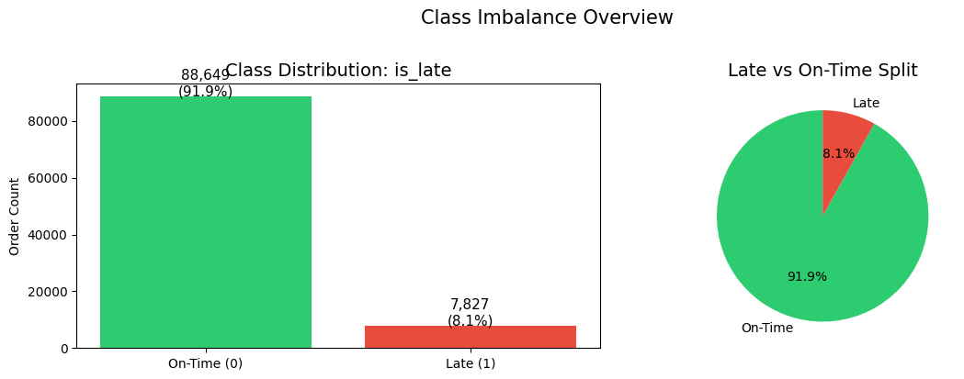
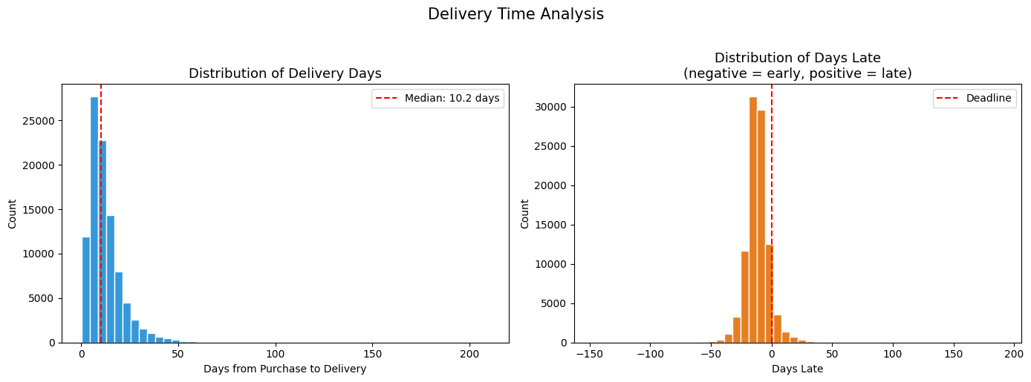
CHECKPOINT 3 · EDA VISUALS
Class Imbalance & Delivery-Time Distributions
Severe 92:8 class imbalance is the central modelling challenge — a naive always-on-time model scores 91.9% accuracy while catching zero late orders.
Delivery days are right-skewed (median 10.2); days-late is measured against the promised delivery deadline.
12

Slide 13
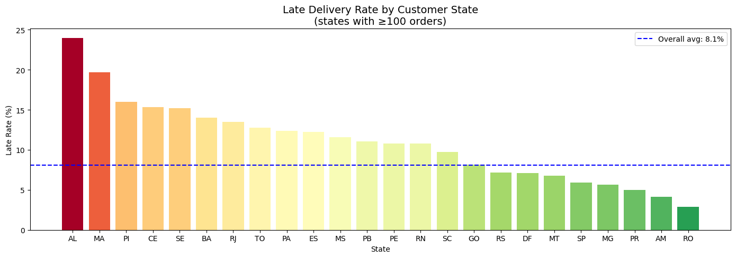
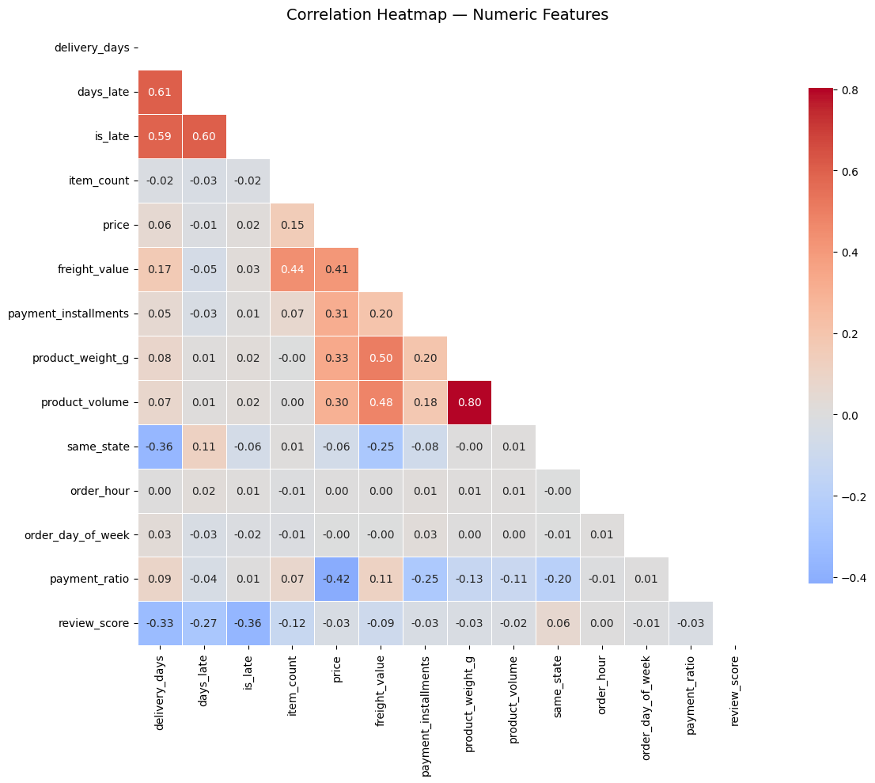
CHECKPOINT 3 · EDA VISUALS
Late-Delivery Rate by Customer State & Correlation Heatmap
Late rates range from 2.9% (Rondônia) to 23.9% (Alagoas) against an 8.1% national average — the clearest, most actionable pattern in the data.
same_state and freight_value are the strongest pre-delivery correlates of lateness — both remain weak (|r| < 0.06).
13

Slide 14
CHECKPOINT 4
04
Final Analysis &
Machine Learning
Final Features · Models · Training & Testing · Results · Interpretation

Slide 15
CHECKPOINT 4 · FINAL MODELLING SETUP
Final Dataset, Features & Target Variable
96,476
16
63
77,180 / 19,295
Rows in
orders_enriched
Raw predictive
features selected
Columns after
one-hot encoding
Train / test rows
(stratified 80/20)
TARGET VARIABLE
is_late — 1 if delivered after the estimated date, 0 if on time. Confirmed 8.1% positive rate preserved identically in both the train and test splits via stratification.
FEATURES USED (KNOWN AT ORDER TIME — NO LEAKAGE)
Order/Payment
item_count, price, freight_value, payment_installments, payment_type
Product
product_weight_g, product_length_cm/height_cm/width_cm, product_volume
Time
order_hour, order_day_of_week
Geography
customer_state, seller_state, same_state
Excluded by design: delivery_days, days_late, review_score — all only known after delivery, so including them would leak the answer into the prediction.
16

Slide 16
CHECKPOINT 4 · MODELLING APPROACH
Machine Learning Models Used & Why
Logistic Regression
Decision Tree
Random Forest
K-Nearest Neighbours
XGBoost
Interpretable baseline with probability outputs; a reference point every other model must beat.
Visualisable rules (max_depth=6) for a human-readable view of what drives a late-order flag.
Ensemble of trees for a stronger, less overfit baseline plus feature-importance ranking.
Similarity-based approach as a non-parametric contrast to the other model families (K=11, elbow-selected).
Gradient boosting — expected top performer on tabular data; used scale_pos_weight for imbalance.
Selection rationale: the five models span the interpretability → performance spectrum, letting the paired t-test (Checkpoint 4 results) show whether the extra complexity of ensembles/boosting actually earns a statistically significant improvement over the simple baseline.
17

Slide 17
CHECKPOINT 4 · MODELLING APPROACH
Model Training & Testing Process
1
Split
Stratified 80/20 train/test split — 8.1% late rate preserved identically in both sets.
2
Scale
StandardScaler fit on the training data only, then applied to test data (fit-on-train, transform-both — prevents leakage).
3
Balance (train only)
SMOTE applied inside every cross-validation fold and once on the full training set before the final fit. The test set is never touched by SMOTE, so evaluation reflects the real 92:8 imbalance.
4
Cross-validate
10-fold stratified cross-validation, F1-score as the primary metric, run through an imblearn Pipeline so SMOTE only ever sees training folds.
5
Tune
RandomizedSearchCV (20 iterations, 5-fold, F1-scoring) tunes XGBoost's max_depth, learning_rate, n_estimators, subsample, and colsample_bytree; the tuned model is refit and re-evaluated.
6
Test & threshold-tune
Final fit evaluated once on the untouched test set; a precision-recall sweep finds the F1-maximising decision threshold for XGBoost.
18

Slide 18
CHECKPOINT 4 · MODEL RESULTS
Model Comparison — Test Set Performance
Model | Accuracy | Precision | Recall | F1-Score | ROC-AUC | CV F1 (10-fold)
Logistic Regression | 0.557 | 0.103 | 0.580 | 0.175 | 0.590 | 0.206 ± 0.02
Decision Tree | 0.557 | 0.100 | 0.555 | 0.169 | 0.560 | 0.153 ± 0.02
Random Forest | 0.681 | 0.107 | 0.401 | 0.169 | 0.581 | 0.178 ± 0.02
KNN (K=11) | 0.605 | 0.097 | 0.463 | 0.160 | 0.564 | 0.167 ± 0.02
XGBoost | 0.252 | 0.089 | 0.893 | 0.162 | 0.611 | 0.160 ± 0.02
Best F1-Score: Logistic Regression (0.175) Best ROC-AUC: XGBoost (0.611) Best Recall: XGBoost (89.3%)
Paired t-test (10-fold CV F1, all model pairs): every pairwise difference is statistically significant at p < 0.05. CV F1 (0.15–0.21) is consistent with the test-set F1 (0.16–0.18) shown above — a small, expected gap rather than a large unexplained one, confirming the leakage-free SMOTE-in-CV setup is behaving as intended.
19

Slide 19
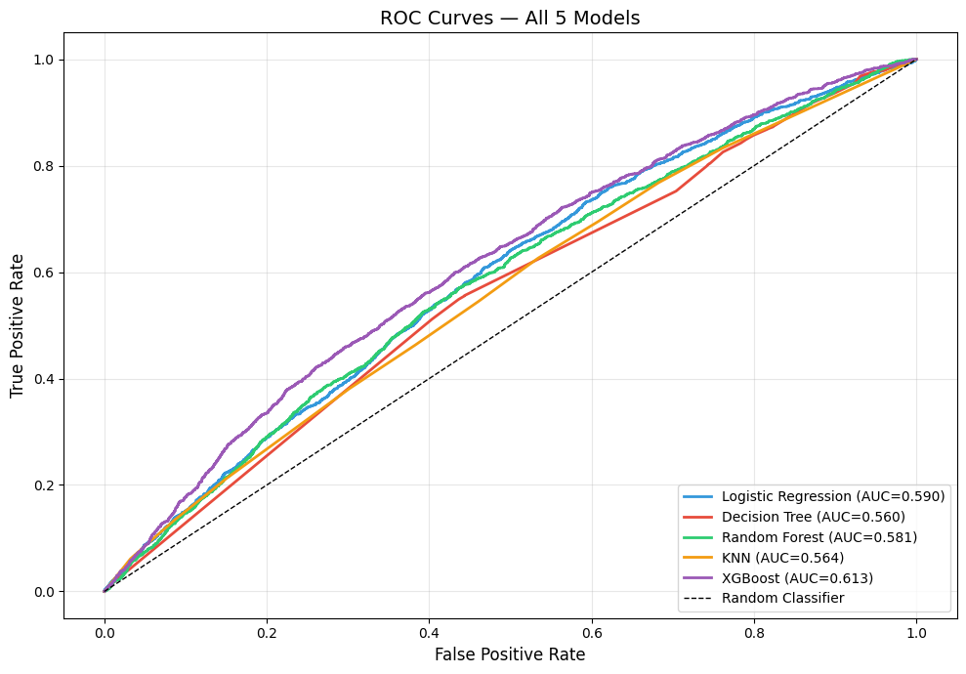
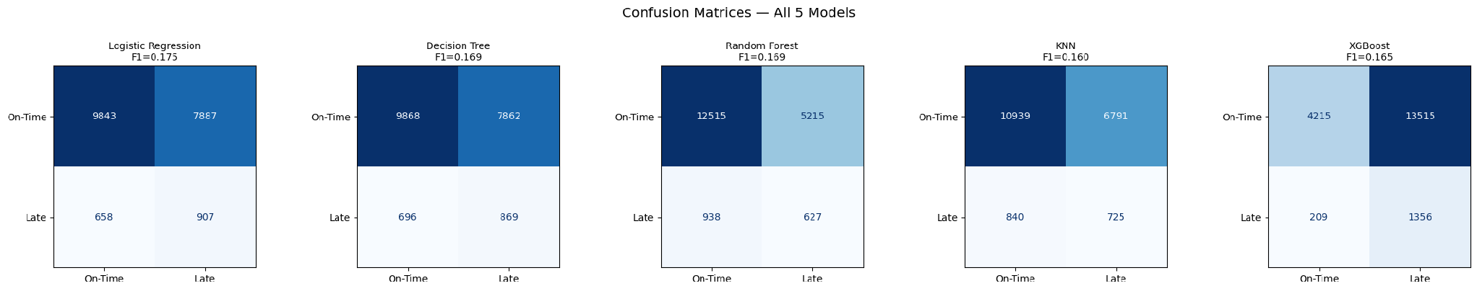
CHECKPOINT 4 · MODEL RESULTS
ROC Curves & Confusion Matrices — All Five Models
ROC-AUC of 0.56–0.61 across all five models — genuine but modest ranking ability, well short of a strong classifier.
XGBoost catches the most late orders (highest recall) but at the cost of far more false alarms than the other models.
20

Slide 20
CHECKPOINT 4 · MODEL RESULTS
Threshold Tuning & Confusion Matrix (XGBoost)
0.728
0.192
46.3%
87.9%
Tuned decision
threshold
F1 at tuned
threshold (vs 0.162)
Recall at tuned
threshold
False alarm rate
at tuned threshold
CONFUSION MATRIX AT TUNED THRESHOLD (test set, n = 19,295)
 | Predicted On-Time | Predicted Late
Actual On-Time | TN = 12,496 | FP = 5,234
Actual Late | FN = 841 | TP = 724
What this means
The model catches under half of true late orders (recall 46%) and flags almost 9 false alarms for every real catch (precision 12%). Useful only as an early-warning signal for human review — not for automated action.
22

Slide 21
CHECKPOINT 4 · INTERPRETATION
What the Model Results Mean
Ranking ability exists, precision does not
ROC-AUC of 0.56–0.61 across all five models shows genuine, if modest, discriminatory power — the models can rank orders by risk better than random. But at any single decision threshold, precision stays under 13%, meaning most 'late' flags are false alarms.
Recall vs. precision is a real trade-off here
XGBoost trades almost all precision for recall (89% recall, 9% precision) — it flags most true late orders but drowns them in false positives. Logistic Regression sits closer to balanced (58% recall, 10% precision, best F1).
The imbalance problem was correctly handled, not solved
SMOTE + leakage-free CV + F1/AUC scoring did their job — CV and test F1 now agree (≈0.16–0.21) as shown on the results slide. The low absolute scores reflect a hard problem, not a broken pipeline.
Order-level features have a performance ceiling
Even the best model (XGBoost, AUC 0.611) is well short of a strong classifier. This points to missing information — not a fixable modelling error — as the main limiter (see Limitations).
23

Slide 22
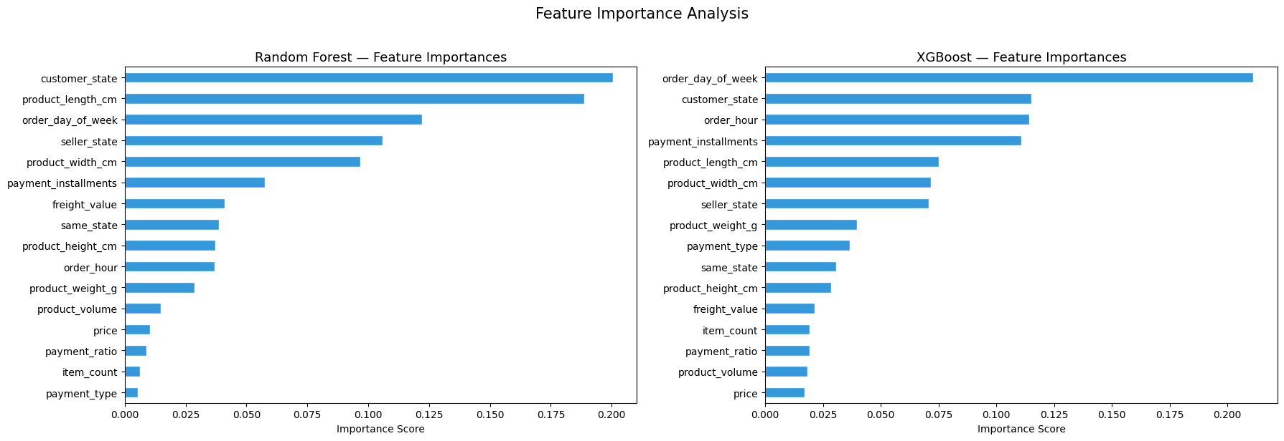
CHECKPOINT 4 · MODEL RESULTS
Feature Importance — Random Forest vs. XGBoost
Geography (customer_state) and order-timing features dominate both models' importance rankings.
24

Slide 23
CHECKPOINT 4 · SUPERVISOR FEEDBACK
Addressing Checkpoint 3 Feedback (1/2)
Q1 — Is a 0.16–0.17 F1-score useful in a real logistics system, or does it create too many false alarms?
At the default threshold, XGBoost's 89% recall comes with only 9% precision — roughly 10 of every 11 flags are false alarms; the false-alarm rate stays at 88% even at the tuned threshold. Used as an automated trigger, this would indeed create far too much noise.
Fix: don't use it as a binary automated trigger. ROC-AUC of 0.611 shows real ranking ability, so the model is repositioned as a risk-based triage tool — review the top-N% highest-risk orders each day (capacity-bounded), not every flagged order. High recall becomes an asset for that use case rather than a liability.
Q2 — Does LabelEncoder create a false numeric relationship between states? What encoding is better?
Yes. Checkpoint 3 encoded customer_state/seller_state with LabelEncoder, assigning arbitrary integers (AC=0, AL=1, AM=2…) that imply an ordinal relationship and numeric “distance” between states that doesn't exist — most damaging for Logistic Regression and KNN, which use those integers directly in coefficients/distances.
Fix: switched to one-hot encoding for customer_state, seller_state, and payment_type in the final pipeline (16 → 63 columns) — each state is now an independent binary column with no implied order. Target/frequency encoding is noted as a future option to cut dimensionality without reintroducing false ordinality.
25

Slide 24
CHECKPOINT 4 · SUPERVISOR FEEDBACK
Addressing Checkpoint 3 Feedback (2/2)
Q3 — What additional data would make this model more reliable for real-world late-delivery prediction?
Section 4.6 traced the model's performance ceiling (ROC-AUC ≈ 0.61) to missing operational information rather than a fixable modelling error. The following external data sources would plausibly close that gap:
Carrier tracking / scan events
Seller dispatch latency
Precise shipment distance
Weather & calendar effects
Seller / carrier track record
In-transit milestones (hub arrival/departure, out-for-delivery) so risk can update as an order progresses, not just at purchase.
Time between order placement and hand-off to carrier — not currently isolated from total delivery time.
Actual geodesic/road distance between seller and customer, replacing the coarse same_state flag.
Adverse weather and public holidays along the delivery route — flagged repeatedly in the literature reviewed.
Rolling historical on-time rate per seller and per carrier, as a proxy for operational risk.
These needs map directly onto the Future Improvements in Section 5.4 — the most concrete, evidence-based path to a materially more reliable model.
26

Slide 25
FINAL SYNTHESIS
05
Findings, Recommendations
& Conclusion
Key Findings · Recommendations · Limitations · Future Work · Conclusion

Slide 26
FINAL FINDINGS
What the Full Analysis Tells Us
Geography is the strongest reliable driver
Class imbalance makes accuracy meaningless here
State-level late rates range from 2.9% (RO) to 23.9% (AL) against an 8.1% national average — by far the clearest, most actionable pattern in the data.
All five models plateau at 0.16–0.18 test F1 despite SMOTE — a stable, expected result once accuracy is dropped in favour of F1/ROC-AUC.
XGBoost is the best risk-ranking model, not a precise classifier
Order-level features carry only weak individual signal
Best ROC-AUC (0.611) and recall (89%) make it the strongest early-warning candidate; its low precision (9%) means it cannot drive automated action on its own.
same_state and freight_value are the strongest usable correlates of lateness, and both are weak (|r| < 0.06) — the dataset is missing the operational data that most likely explains most lateness.
28

Slide 27
FINAL SYNTHESIS
Recommendations & Limitations
RECOMMENDATIONS
LIMITATIONS
Deploy the tuned XGBoost model as an early-warning flag routed to human review — not as an automated trigger, given its low precision.
Prioritise logistics investment by state — geography is the most actionable, reliable signal identified in this project.
Add a seller-level historical late-rate feature as a proxy for operational risk not otherwise captured.
Enrich the dataset with carrier tracking events, weather, and warehouse dispatch-time data before expecting materially better precision.
ROC-AUC ceiling of ~0.56–0.61 suggests this feature set has a low performance ceiling regardless of model choice.
SMOTE fixes training-set balance, not the underlying information gap — precision stays low at any usable recall.
The KNN elbow search selected K on SMOTE-resampled data rather than isolating it to training folds only — a mild leakage risk flagged for future iterations.
A feature-name/column-index mismatch in the feature-importance and decision-tree plots was identified and corrected during Checkpoint 4 QA; rankings should be treated as indicative pending a final re-run.
29

Slide 28
FINAL SYNTHESIS
Future Improvements & Conclusion
FUTURE IMPROVEMENTS
Cost-sensitive learning
Seller history features
External enrichment
Smarter encoding
Explore focal loss / class-weighted objectives alongside or instead of SMOTE.
Merge seller-level historical on-time rate as a leakage-safe proxy for operational risk.
Bring in weather, public holidays, and carrier tracking events.
Try target/frequency encoding for state features to cut the 63-column one-hot footprint and sharpen feature-importance interpretation.
CONCLUSION
This project delivered a complete, leakage-free pipeline — from raw Olist tables through EDA, feature engineering, five compared classifiers, and statistical validation — to predict late deliveries. The strongest, most actionable finding is geographic: late rates triple across Brazilian states, a clear lever for operational fixes. The models themselves confirm genuine but modest predictive signal (ROC-AUC ≈ 0.61) rather than a strong classifier, correctly reflecting that order-level data alone cannot fully explain delivery lateness — richer, external logistics data is the natural next step.
30

Slide 29
Thank You
Questions & Feedback Welcome
5
0.611
8.1%
23.9%
Models
compared
Best ROC-AUC
(XGBoost)
Late-delivery
rate
Highest-risk
state rate
Renato Silva | Sandra Raj Pattuvakkaran | Sudarsh Mekkampurath Sajeev
DA01 — Data Analytics | University of Europe for Applied Sciences — Dubai | Checkpoint 4 | July 4, 2026

